Slide 1

TEAM 6
FINAL PROJECT
YVETTE SAUL
JESUS MATA
ANDREW KLIEVER
KEN PRIEST

Slide 2

AI-Powered Travel Recommendation System
Our project leverages machine learning and real-time API data to predict travel destinations based on user input and recommend hotels & attractions.
Model Training
We trained a Random Forest Classifier using a dataset that includes travel details such as:
Accommodation Cost
Traveler’s Age
Duration of Stay
The model was specifically trained to predict the most likely travel destination based on these three key factors.
Prediction & API Integration
When a user inputs their accommodation budget, age, and duration, our trained model predicts the most probable destination.
After predicting the destination, we integrate TripAdvisor’s API to pull real-time hotel and attraction recommendations.
Additionally, we use the Pexels API to fetch a relevant city image.
Key Insights
Accommodation cost played a major role in predicting destinations, meaning that travelers' budgets significantly influenced their predicted location.
The system provides dynamic, real-time travel recommendations, ensuring relevant and up-to-date results for users.

Slide 3
Hurdles and Lessons Learned
Datasets started off being problematic
Initially we were getting low prediction %’s
Trouble merging data based on finding like data fields we wanted to utilize
Fork over the cash and pay for APIs from the start
Save time
Reduce stress
Better data quality
Resulting in a better product

Slide 4
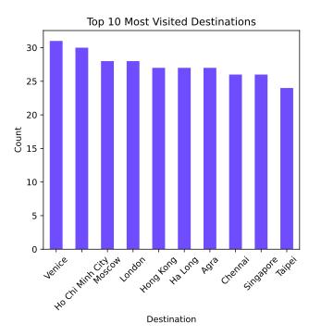
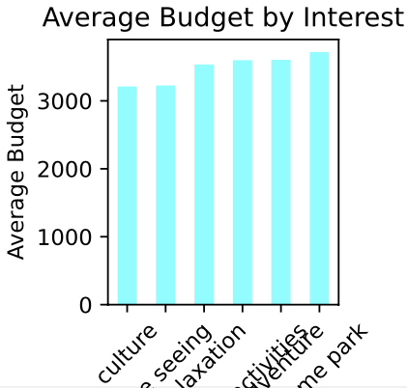
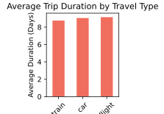
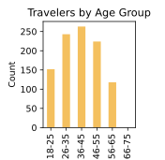
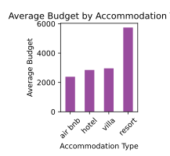

Slide 11
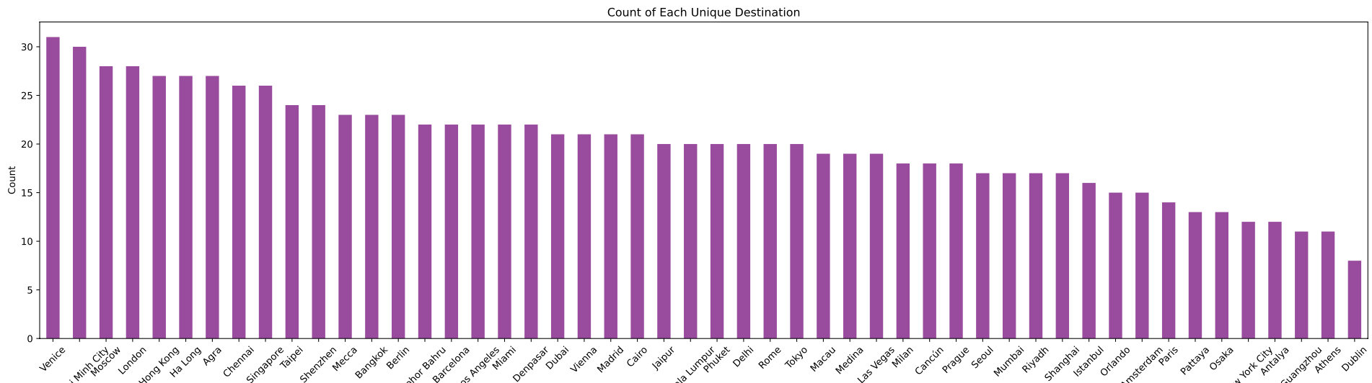

Slide 12
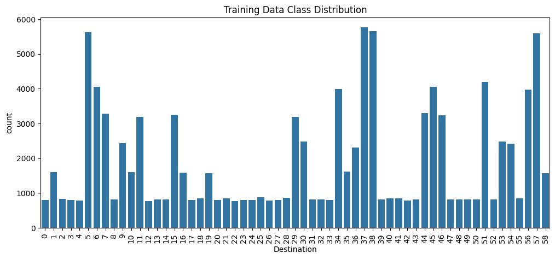

Slide 13
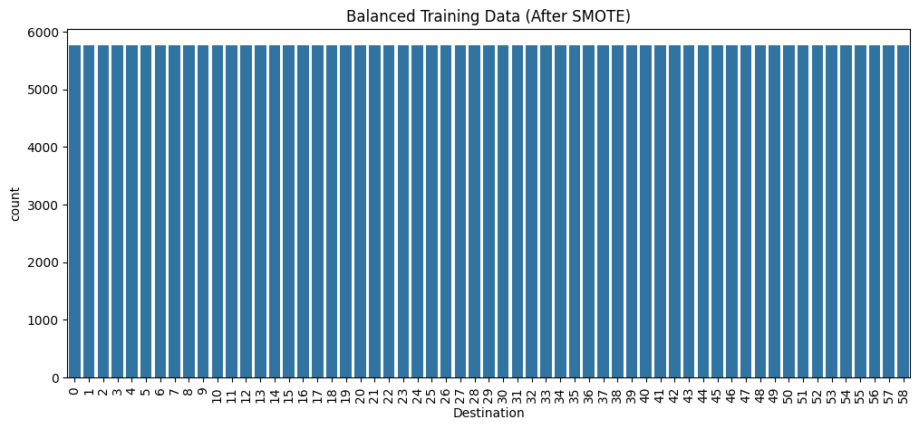

Slide 14
